Slide 1
INTELLIGENT TRANSPORTATION SYSTEM
GUIDED BY: REPRESENTED BY:
DR. VANDANA BHATTACHARJEE NAMRATA KUMARI
(MT/ITY/10007/18)

Slide 2
CONTENTS
Introduction to Intelligent Transportation System(I.T.S)
Features of I.T.S which is practiced in the world
Problems in transportation
Technologies
The I.T.S status in India
Implementation of I.T.S
Reference

Slide 3
INTRODUCTION
Intelligent Transport Systems (ITS) intend to add information and communications technology to transport infrastructure and vehicles in an effort to improve:
Safety
Reliability
Efficiency
Quality of means of transport

Slide 4
INTRODUCTION
Intelligent Transportation Systems (ITS) is a set of tools that allows technology to improve the efficiency and safety on roadways.
By providing agencies the ability to “see” the current traffic conditions and manage the roadway system in real time.
This is greatly beneficial when dealing with an incident.
It allows agencies to visually evaluate the incident and determine the necessary equipment and personnel needed without having to physically be at the site and quickly dispatching the proper response equipment and staff, thus saving time and, more importantly, lives.

Slide 5
PROBLEMS IN TRANSPORTATION
TRAFFIC CONGESTION
FUEL CONSUMPTION
TO REDUCE ROAD ACCIDENTS

Slide 6
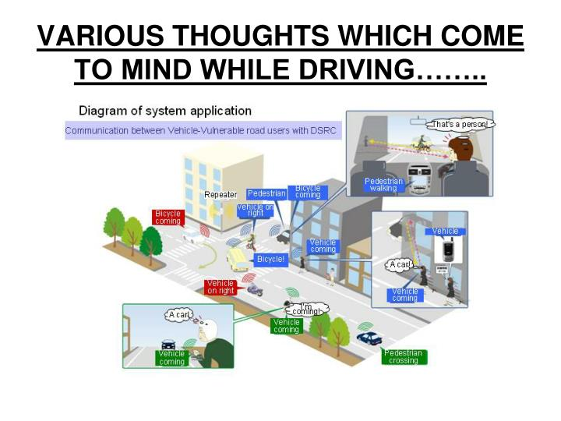

Slide 7
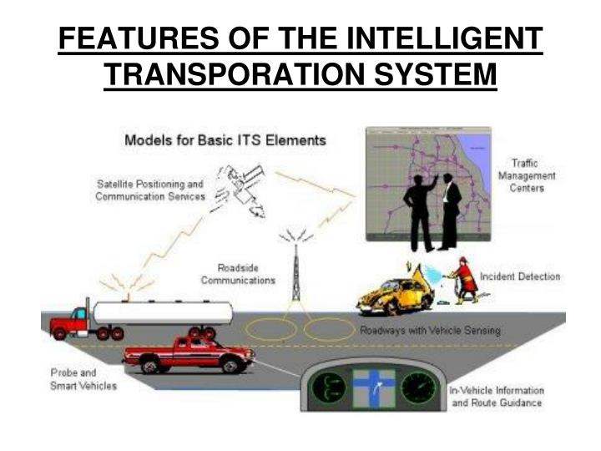

Slide 8
Intelligent transportation technologies
Wireless communications
Computational technologies
Sensing technologies
Video vehicle detection
Probe & smart vehicles
The incident detection centers
In vehicle information & route guide

Slide 9
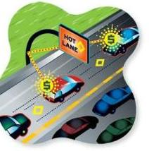
Intelligent transportation applications
Electronic toll collection
Emergency vehicle notification systems
Automatic road enforcement
Hot lanes

Slide 10
ITS Elements
RTMC (regional traffic management center)Hardware
stable platform
RTMC Software
Application software
• Device drivers
• Operating system software
• Database
• Other commercial off the shelf packages

Slide 11
I.T.S REQUIREMENTS IN INDIA
Number of vehicles – Risen hence road accidents have also increased.
World’s highest annual road fatalities - 80,000 persons killed on Indian roads every year.
I.T.S India project –
To improve road safety and the efficiency of transportation systems.

Slide 12
ROAD SAFETY IN INDIA
Ownership of cars in India - 6 per thousand of population as against 500 in developed economies.
Number of fatalities per 10,000 vehicles - 14.39 in India, compared to 1.0 to 2.50 in many high income countries
Causes Of Road Accidents
➢ Driver’s fault -83.5%
➢ Pedestrian fault/fault of passengers -4.7%
➢ Mechanical defect in vehicles -3%
➢ Bad roads -1.1%
➢ Bad weather -0.9%
➢ Other factors-6.8%
E.g :cattle, fallen trees, road blockages, non-functioning of signals and
absence of rear reflectors/road signs

Slide 13
EMERGENCY MANAGEMENT SYSTEMS
➢ Sense the type of emergency and the location
➢ Reach the victim with appropriate personnel and equipment, as required
➢ Care for the victim as appropriate
➢ Feedback to enable audit and healthy evolution of the system and its services.

Slide 14
PUBLIC TRANSPORT
Improving the accessibility and attractiveness that help reduce congestion in towns and cities.
Public transport management has the important task of coordinating the various forms of public transport to allow multi-modal travel.

Slide 15
Increase Existing Infrastructure Capacity
Simple:
More people per vehicle (carpool, bus)
Smaller vehicles (motorcycles)
Narrow lanes

Slide 16
Increase Existing Infrastructure Capacity
complex:
Vehicle automation
Variable speed limits
Variable use facilities
Traffic monitoring

Slide 17
CONCLUSION
The rapid increase in e_Safety is in growing demand to the day.
The making of new vehicles should be well equipped with necessary technologies.
To change the road user culture. This includes stronger levels of traffic regulation and enforcement.

Slide 18
Finally to sum up
Raising awareness on ITS and road safety
protecting vulnerable road users
Traffic Management
Emergency Response Management
Commercial Vehicle Operations
Traffic and Traveler information
Public Transport Management

Slide 19
Reference
Transportation Planning & Engineering – BY P.S.Papacostas & P. D. Prevedorous
incog.org
Internet

Slide 20
THANK YOU!

